Slide 1

User Manual tutorial
Student grading system

Slide 2
Student Grading System is a web application developed by young web developers at KIAC. It is a web application that was developed to solve problems met by students, whereby they weren’t able to receive their marks unless they receive their transcripts at the end of the intake. But student grading system made it easy because either the teacher can add students’ marks easily and also the students may get to see their results and evaluate themselves. additionally, they will be able to print they transcripts.

Slide 3
The System has 4 users AND THEY ALL HAVE TO LOGIN FIRST AS THE SYSTEM MUST RECOGNISE THEM BEFORE GIVING THEM ACCESS TO THE ACTIVITIES CARRIED OUT WITHIN THE SYSTEM, so let’s pass through the users to see all their functionalities…..

Slide 4
ADMINISTRATOR
Admin of this system is mainly assigned to ADD and REMOVE OTHER USERS IN THE SYSTEM, THIS MEANS THAT THE ADMIN HAS FULL CONTROL TO THE USERS ACCESSING THE SYSTEM.

Slide 5
When an admin adds a user or a teacher . The system automatically generates a password according to his role in the system, but this password may be changed later as the user reaches his / her dashboard

Slide 6
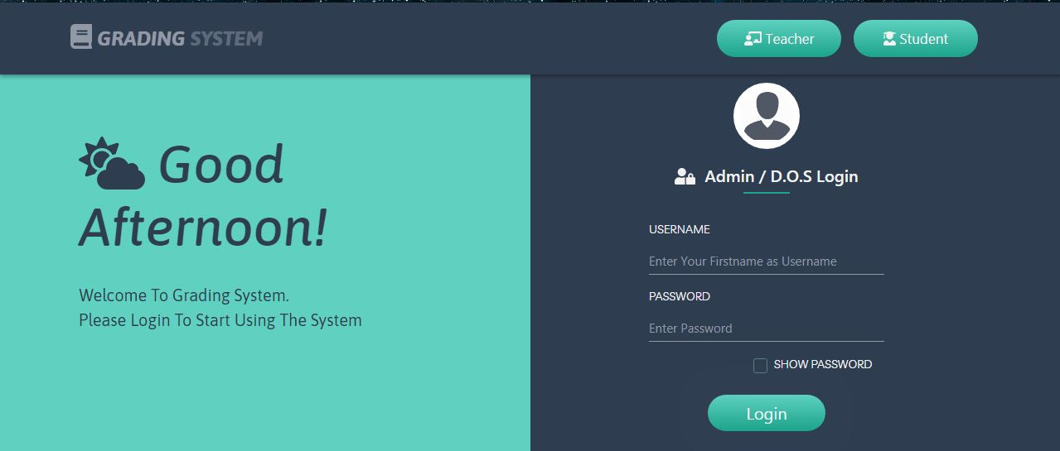
This Is the login interface for admin login

Slide 7
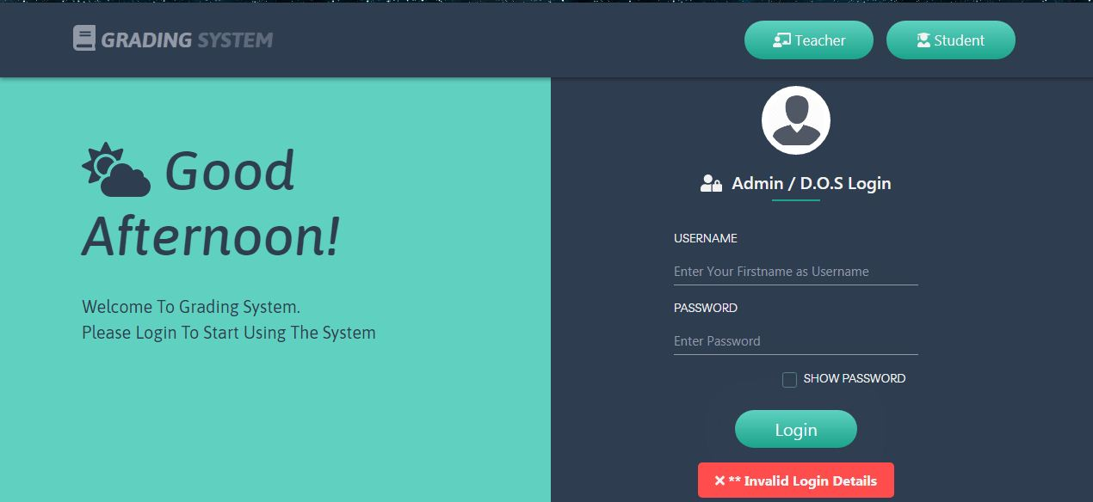
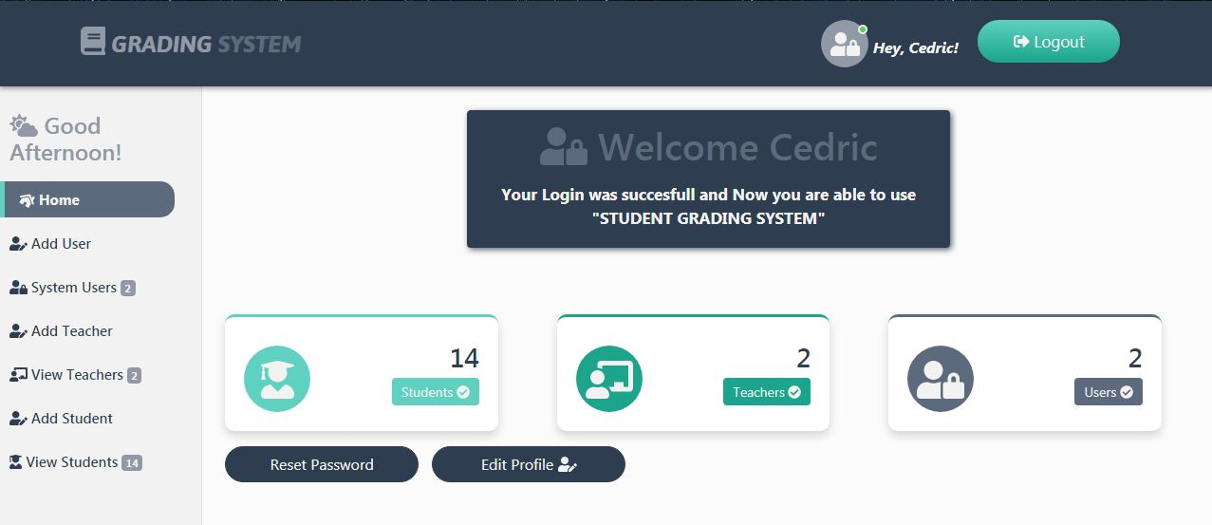
AFTER THE ADMIN ENTERS HIS LOGIN DETAILS….
Login details not valid!
Valid login details

Slide 8
ADMIN LOGIN DETAILS ARE VALID SO HE / SHE IS REDIRECTED TO THE DASHBOARD, SO HERE HE CAN VIEW NUMBER OF USERS IN THE DATABASE, EDIT HIS/HER PROFILE OR EVEN CHANGE HIS / HER PASSWORD

Slide 9
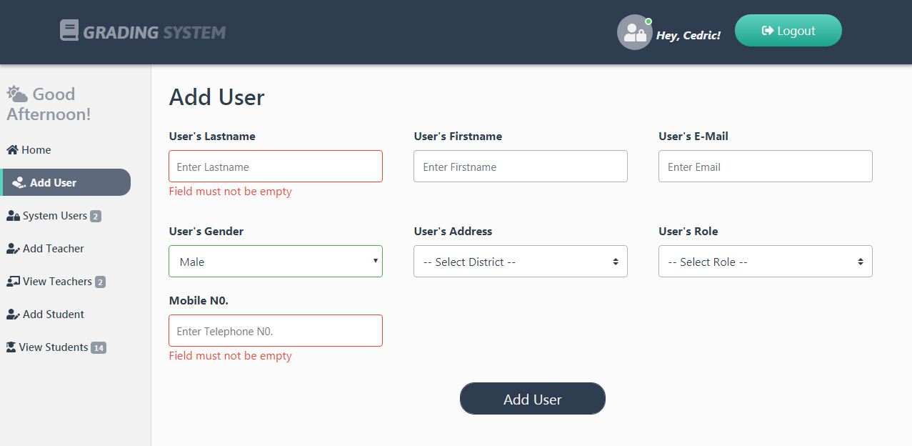
FORM VALIDATION
All the forms in student grading system are validated, so this means you can’t submit a non valid input field! For example: empty field / text in mobile number field

Slide 10
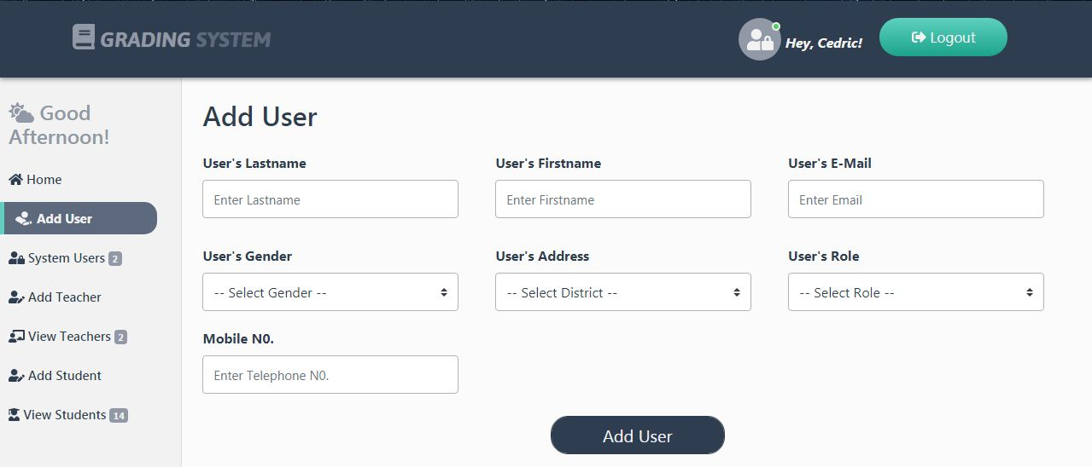
ADDING A NEW USER
When a new user is added he / she receives an email showing his or her password which can’t be visible to the system admins for security reasons

Slide 11
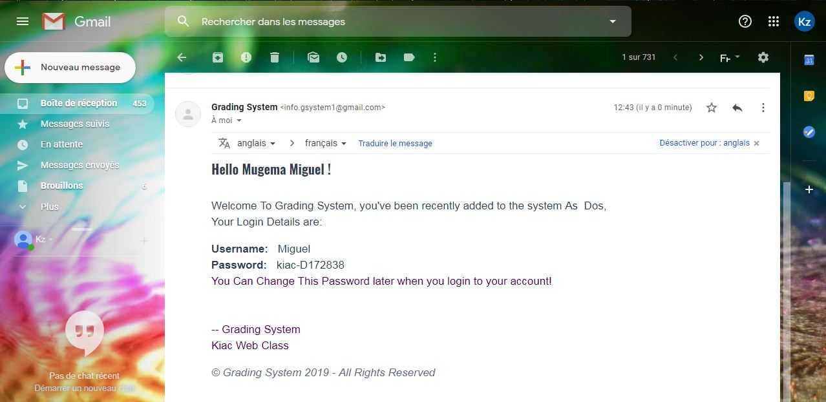
Email received

Slide 12
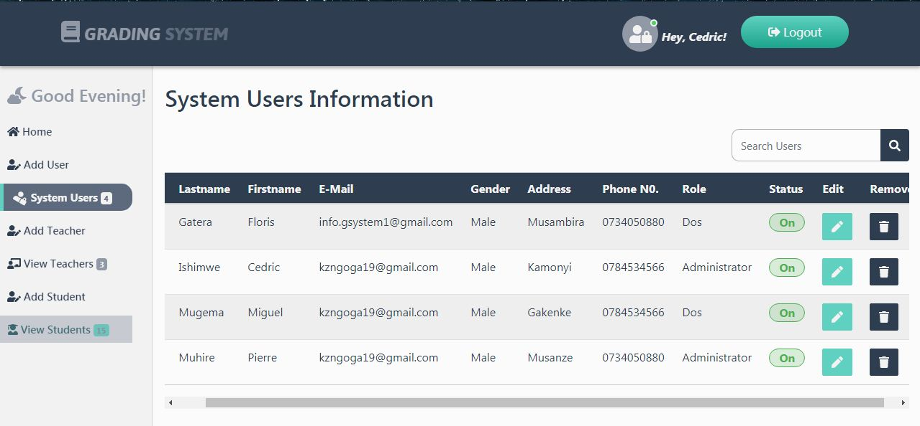
Viewing users’ information

Slide 13
THE ADMIN CAN..
CHANGE USER’S ROLE IN THE SYSTEM(FROM DOS TO ADMIN AND VICE VERSA)
REMOVE A USER FROM THE SYSTEM
RE-ADD THE USER TO THE SYSTEM, AND THIS IS DONE WHEN THE SYSTEM REGENERATES A NEW PASSWORD FOR THE USER!

Slide 14
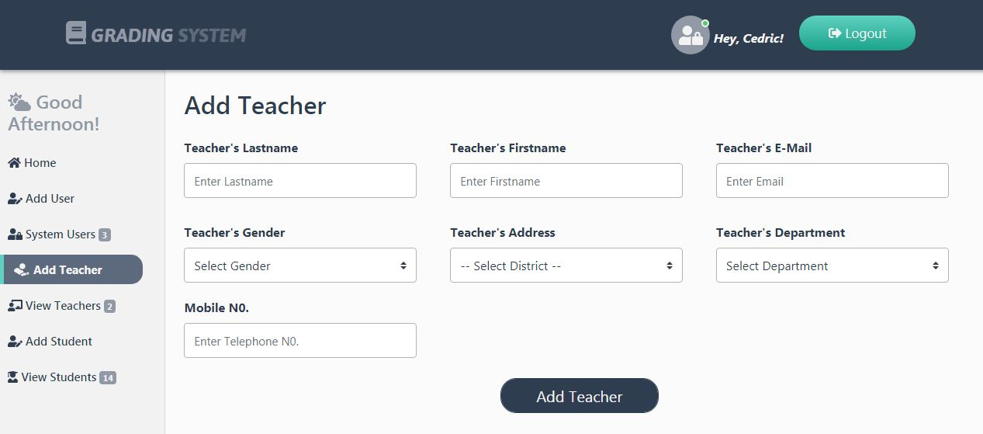
ADDING A NEW TEACHER
When a new teacher is added he / she receives an email showing his or her password which can’t be visible to the system admins for security reasons.

Slide 15

Email received

Slide 16
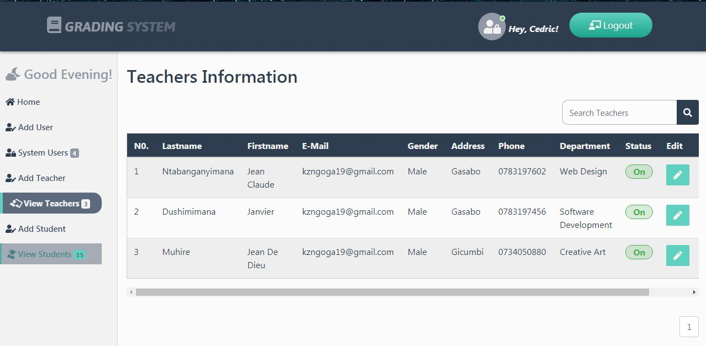
Viewing TEACHers’ information

Slide 17
THE ADMIN CAN..
CHANGE TEACHER’S DEPARTMENT
REMOVE A TEACHER FROM THE SYSTEM
RE-ADD THE TEACHER TO THE SYSTEM, AND THIS IS DONE WHEN THE SYSTEM REGENERATES A NEW PASSWORD FOR THE TEACHER!

Slide 18
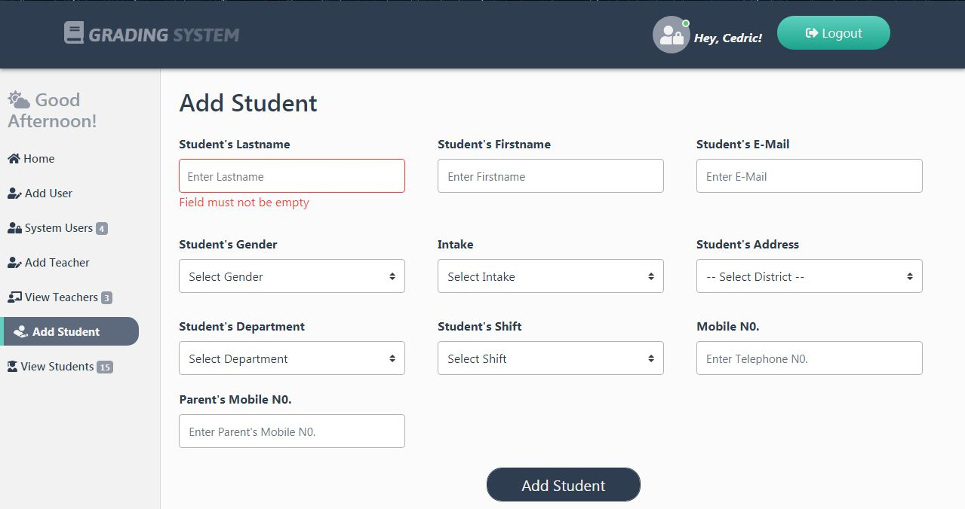
ADDING A NEW Student
When a new student is added he / she receives an email showing his or her registration number to be used when accessing his / her account

Slide 19
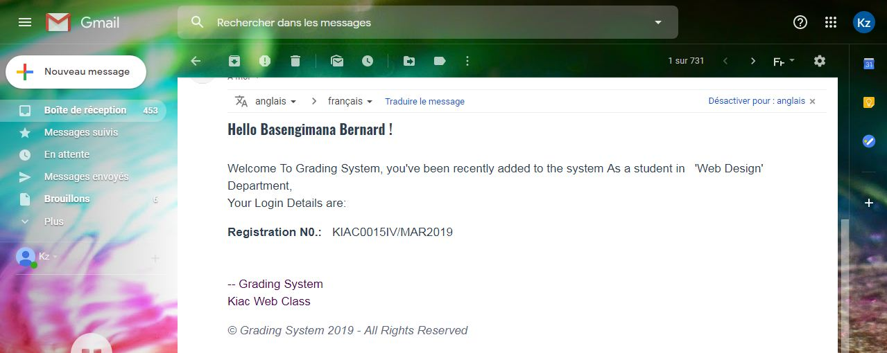
Email received

Slide 20
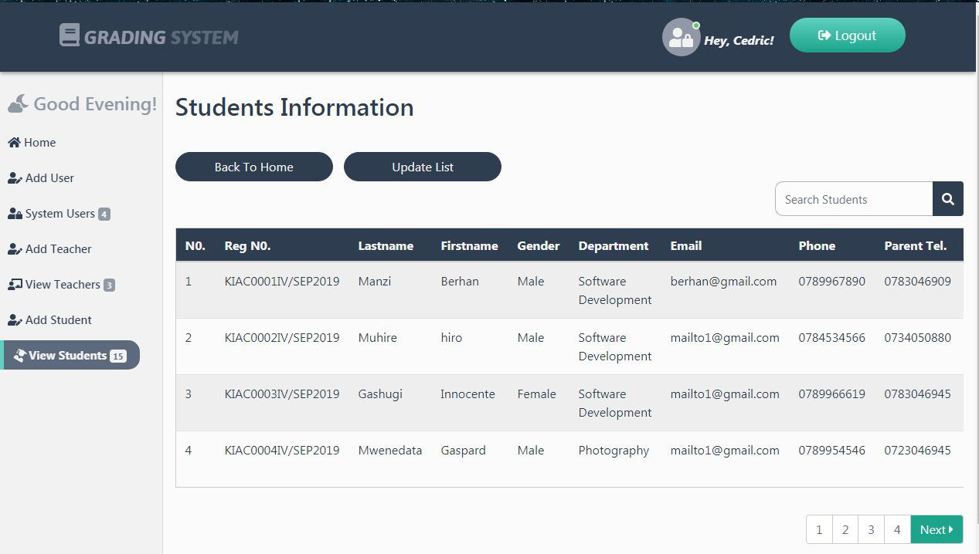
Viewing students’ information

Slide 21
THE ADMIN CAN..
Register a student
CHANGE ACTIVE STATUS FOR A STUDENT(ON/OFF)
UPDATE THE LIST OF STUDENTS TO THE CURRENTLY ACTIVE STUDENTS

Slide 22
REMOVING AND RE-ASSIGNING A USER…

Slide 23
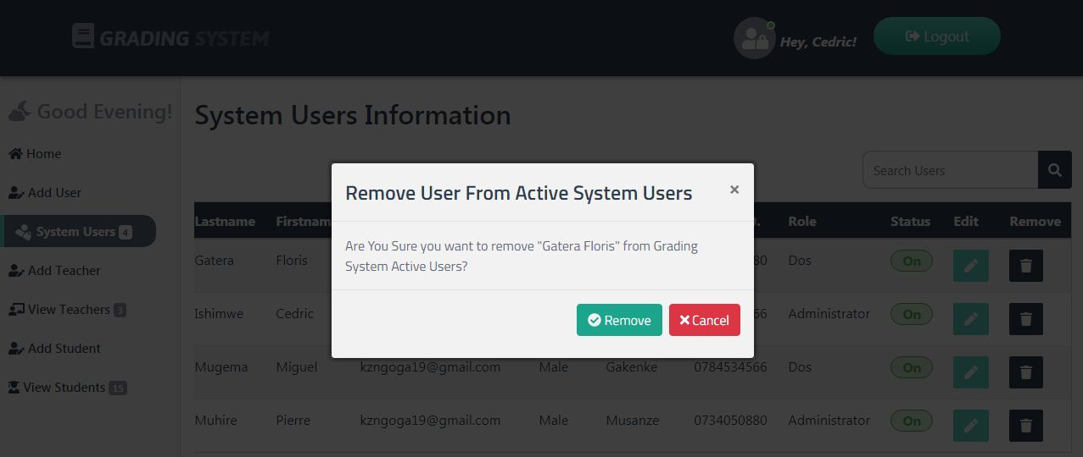
A DIALOG BOX POPS UP FOR THE ADMIN TO CONFIRM IF IT’S THE RIGHT USER TO REMOVE OR IF IT’S THE RIGHT THING HE / SHE WANTED TO DO.

Slide 24
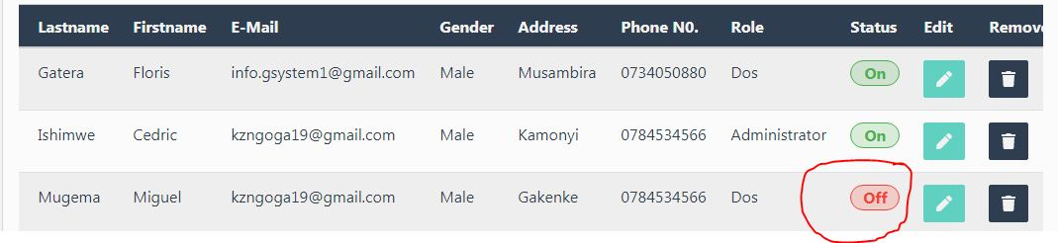
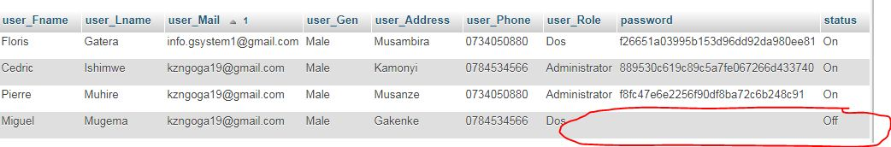
WHEN A USER IS REMOVED FROM THE SYSTEM HIS /HER STATUS IS CHANGED FROM ‘ON’ TO ‘OFF’ TO MEAN HE / SHE IS NO LONGER AMONG THE USERS WHO HAS ACCESS TO THE SYSTEM and the password is retained so that he / she may not access the system any more unless a new password is regenerated

Slide 25
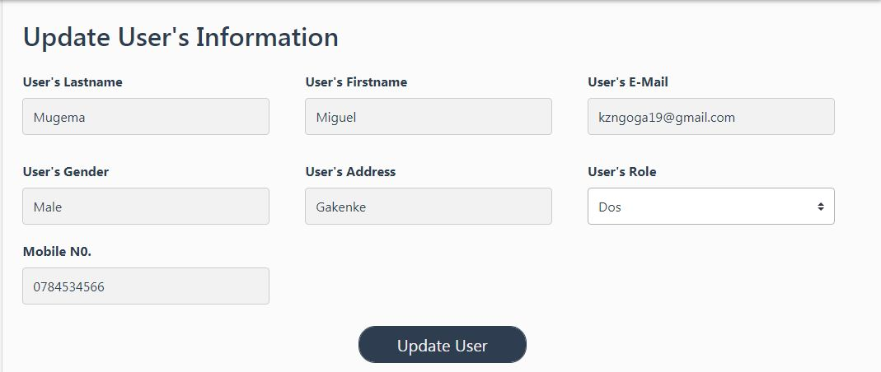
WHEN A USER IS RE-ASSIGNED TO THE SYSTEM A NEW PASSWORD IS GENERATED FOR HIM / HER TO GAIN ACCESS TO USE THE SYSTEM ONCE AGAIN, AND THIS MEANS HIS STATUS IS CHANGED TO ‘ON’ FROM ‘OFF’

Slide 26
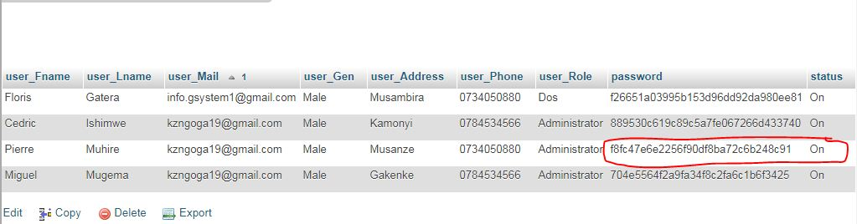
A NEW PASSWORD IS REGENERATED SO HE / SHE HAS BEEN GRANTED ACCESS TO USE THE SYSTEM ONCE AGAIN.

Slide 27
The same processes are followed when removing and reassigning a teacher! Status toggles from ‘on’ to ‘off’ and vice versa.. But for a student his / her student becomes off when a=the admin updates the list at the end of his / her intake.

